Slide 1
Behavioral Monitoring Using Vocal Sentiment Analysis
Project ID : 003
Group Members Roll Number CGPA
Shehroz Waseem CS-18121 3.34
Sukaina Asad CS-18128 3.56
Abaad Murtaza CS-18131 3.62
Aiman Nisar CS-18140 3.12

Slide 2
1.
Introduction

Slide 3
Introduction
Detecting sentiments is one of the most important marketing strategies in today’s world. we could personalize different things for an individual specifically to suit their interest.
Normally sentiment analysis is done through the text data, but the idea of our project is to extract sentiments from audio data to automate the time-consuming task of assessing human emotions.
We have created a model that takes human audio and gives us comprehensive information on how people behave in different situations.
We will extract not just fundamental prosody elements, but also many voice quality features, and combine them to determine emotions like anger, sadness, and happiness in this study.

Slide 4
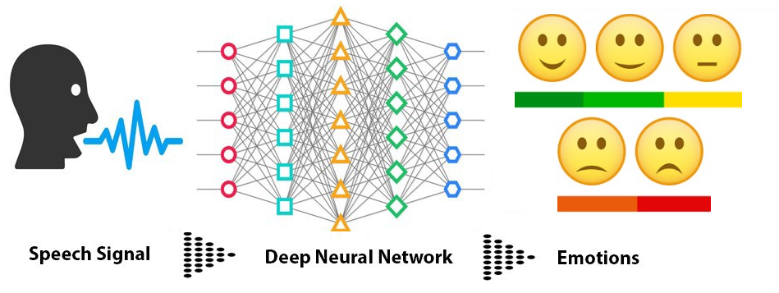
Introduction

Slide 5
2.
Project Background

Slide 6
Project Background
Human emotions or behavior can be monitored using the text data i.e. their lexical features extracted from the text, facial expressions.
If one wants to predict emotions from real-time audio, following the lexical features would necessitate a transcript of the speech, which would necessitate an additional step of text extraction from speech.
The acoustic feature analysis can be done in real-time for which we only require the audio data to identify the emotions as Features extracted from human vocal data hold immense significance for sentiment analysis which gives insights into their emotional health.

Slide 7
WorkFlow
Research
Data Augmentation
Data
Preparation
1
3
5
2
4
6
Data Collection
& Preprocessing
Feature Extraction
Model Development and Testing

Slide 8




Task Division
Aiman Nisar Data Collection, EDA and Data Augmentation
Sukaina Asad Feature Extraction and Data Augmentation
Shehroz Waseem Data Preparation, Model R&D and Result Analysis
Abaad Murtaza Model R&D , Hyper parameter Tuning and Result Analysis

Slide 9
3.
Project Overview

Slide 10
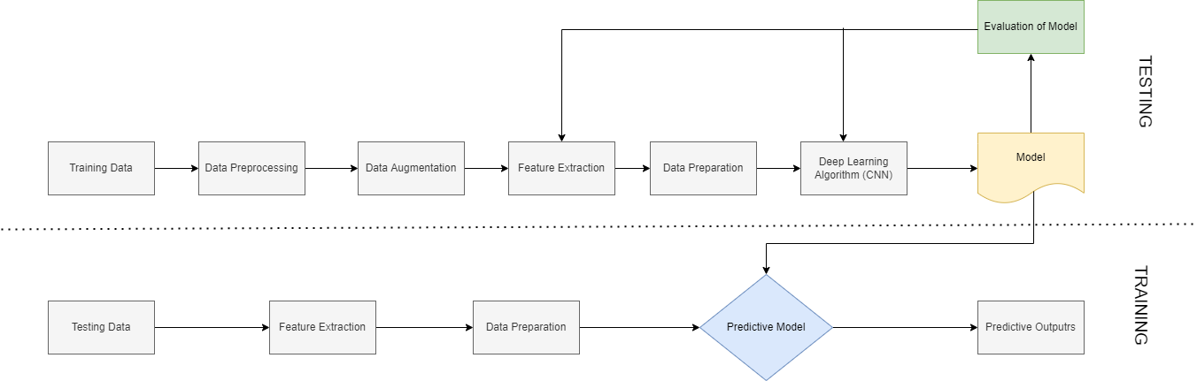
Flow Chart

Slide 11
Data Collection and Peprocessing
We have utilized 4 different publically available audio datasets to predict seven basic human emotions.
Out of all files data sets make up:
CREMA-D 7,442
TESS 2,800
RAVDESS 2,076
SAVEE 480
These datasets were then combined, and preprocessed to remove the excess emotions keeping the dataset balanced.
RAVDESS
SAVEE
Surprise, Happy, Anger, Disgust, Fearful, Sad, Neutral, Calm
CREMA-D
TESS

Slide 12
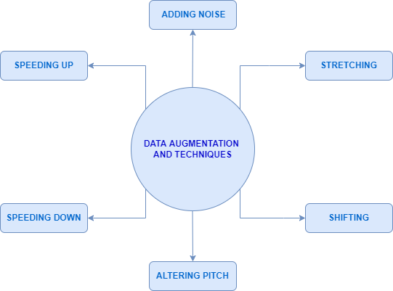
Data Augmentation
Data augmentation is the process of creating further synthetic data samples from our initial training set by adding tiny perturbations.
The goal is to make our model insensitive to those perturbations and improve its generalization ability.

Slide 13
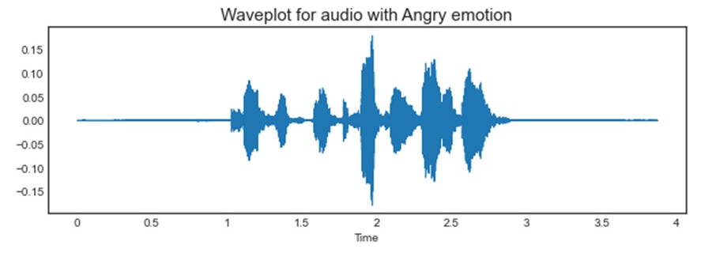
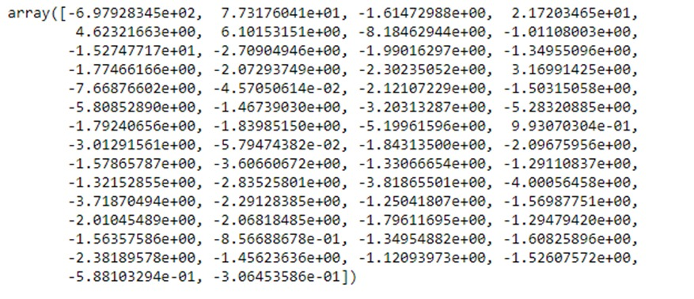
Feature Extraction
For The Mel Frequency Cepstral Coefficients (MFCCs) of a signal are a small set of features which concisely describe the overall shape of a spectral envelope.
For extracting the MFCC feature from audio we have to define the sampling rate which is defined 22050 Hz here along with the number of MFFCs to be extracted are 58 for each audio in the dataset.

Slide 14
Data Preparation
We have scaled our features through the StandarScaler module, it standardize the features in a Normal curve.
Why Standardization? Standardization of a dataset is a common requirement for many machine learning estimators. They might behave badly if the individual features do not more or less look like standard normally distributed data.
Then data is made compatible for the model by using numpy expand dimensions function as it is crucial that the data must be comparable and compatible to avoid mistakes in analyses and interpretation.

Slide 15
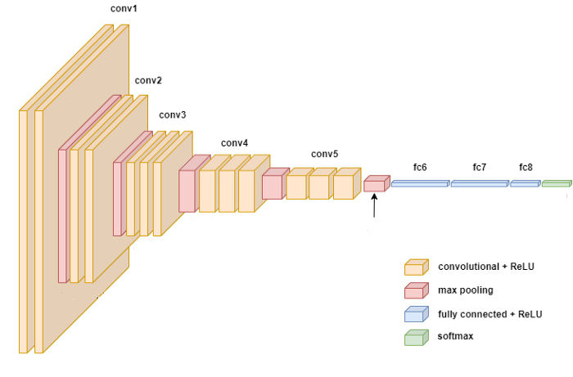
Model Development
Convolutional Neural Networks (CNNs) are a type of deep learning model that had made a lot of success in Speech Data Processing.
CNN can be regarded as a variant of the standard neural network. Instead of using fully connected hidden layers like in other Neural Network approaches, CNN introduces a special network structure, which consists of alternating so-called convolution and pooling layers.

Slide 16
Model Development
A typical CNN is made up of multiple convolutional layers, each of which is followed by a pooling layer and fully connected layers.
The input from the preceding steps is a standardized 1D-vector (array) which is then passed to the convolution layer and further to pooling layers.
The fully connected layer, which is essentially a regular MLP, is the final building block of CNNs. The output from the CNN is a 2D-vector (array).
Other Possible Approaches:
Multi-Layer Perceptron (MLP) Classifier
Long Short-Term Memory (LSTM) Classifier

Slide 17
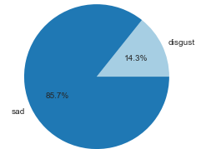
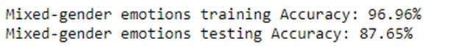
Training and Testing
This complete dataset is divided into two subsets for training and testing of our model.
The model will be trained for 80% of the data and the rest 20% is used for the testing phase for our model.
The accuracy of both sets is as follows:
Results for an audio with sad emotion

Slide 18
Challenges Faced
Initially, we ran our model using the MLP classifier with the RAVDESS DATASET and discovered that while we had greater accuracy, our predictions were not up to par. We discovered that the dataset was insufficient, and that the model prediction performance was also lacking.
We expanded our dataset, collecting four additional datasets in which we encountered class imbalance issues, in which all emotions were not equally represented in the sample. We updated the dataset to address this problem.
We investigated whether CNN, rather than MLP, could be a better approach because to its unique network structure, which includes convolution and pooling layers, and then switched to CNN for prediction.

Slide 19
Challenges Faced
We had a difficulty with data compatibility, so we used data augmentation techniques for our vocal data. We additionally standardized and scaled our data to improve the model's performance.
We used Linear prediction coefficients (LPC) feature extraction from audios in previous techniques, but the results were not very accurate, therefore we went for MFCC feature extraction, which produced higher recognition accuracy in speech recognition systems.

Slide 20
4.
Milestone Summary

Slide 21
Timeline
MODULE 3
Application Development
MODULE 1 | Part -1
Literature Review
MODULE 2 | Part-1
Feature Extraction
MODULE 5
Documentation
OCT 21
NOV 21
DEC 21
JAN 22
FEB 22
MAR 22
APR 22
MAY 22
JUN 22
JUL 22
AUG 22
SEP 22
MODULE 2 | Part-2
Model Development
MODULE 4
Integration and Testing
MODULE 1 | Part-2
Data Collection and Organization

Slide 22

Achieved Milestones
Module 1 | Part-1
Literature Review (Completed)
Module 2 | Part-1
Feature Extraction (Completed)
Module 1 | Part-2
Data Collection and Organization (Completed)
Module 2 | Part-2
Model Development (In Progress)

Slide 23
5.
Future Plan

Slide 24
Future Milestones
Application Development
Improvement in model
Documentation
Report Generation Feature
Integration & Testing

Slide 25
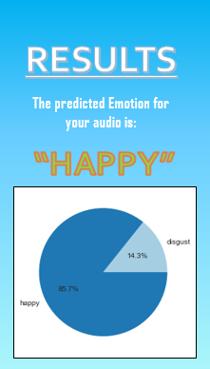
Final Deliverable
A mobile application which will feature a live recorder that classify emotions on real time audio data.

Slide 26
Thank You

